Slide 1
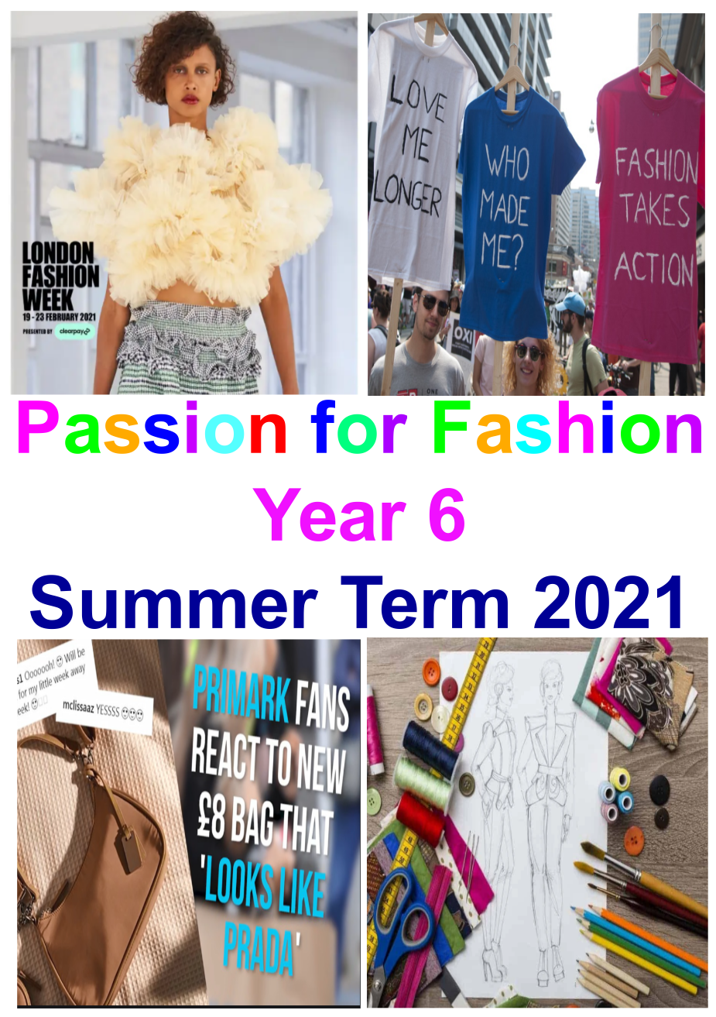
What has worked well?
Healthy Eating Lunch - Pizza in legacy garden
Reproduction talks in science
Developing our photography skills
Creating and editing our Magazines
Learning about “Fairwear”
Having the opportunity to talk to
Holly Hickman about modelling
Learning how to “sign” together
Team assemblies & being back in the hall
Planning & running PE session
with Reception
Our upcycling designs &
photoshoot
Smaller groups for PE sessions
Writing & rehearsing our Performance
.
Whole school Sports Day
Rocket workshop with the Royal Navy
Zoom meeting with Chamiah Dewey &
Learning about the challenges of fashion for Little People

Slide 2
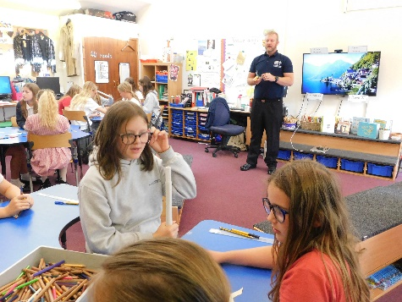
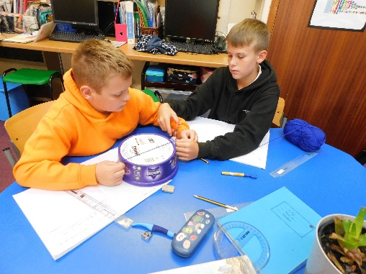
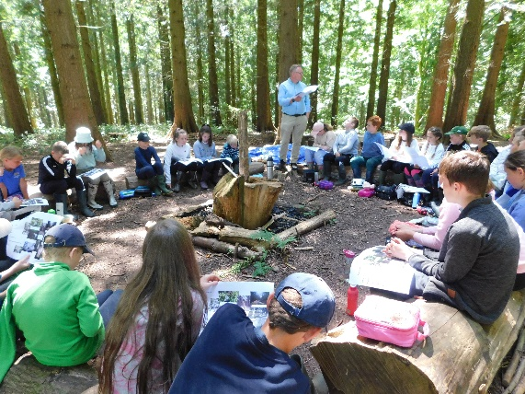
What has challenged you?
Putting our performance together &
rehearsing it to get it right
Completing different investigations in
maths:
Fibonacci - garden design
Circles – calculating Pi
Designing & making our range
of Upcycled clothes
.
Writing lyrics & melodies for our end of
year performance
Learning “signing” as part
Of a whole school challenge
Designing & making our small animal from chicken wire
Working together to make write & produce our teen magazine

Slide 3
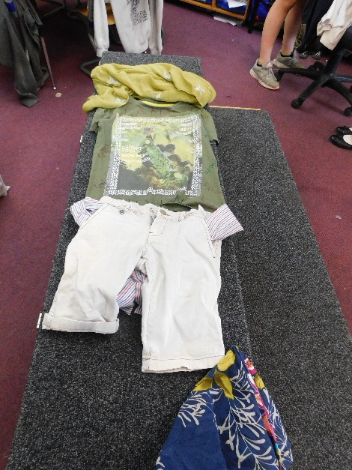
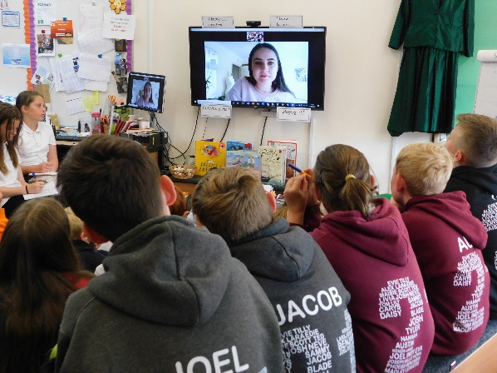
What has surprised you about your theme?
Finding out about “Upcycling” & how it is becoming more and more popular, especially amongst designers and celebrities.
The impact of “Fast fashion” on the environment & what we can do to make our clothes more sustainable.
Learning about “Fairwear” and what they are doing to improve the working conditions and pay for textile workers around the world.
Learning that some people find it difficult to follow fashion –
e.g. little people or disabled have not been catered for
That the two world wars had such an affect on fashion
Finding out about the Suffragettes and what they did for women

Slide 4
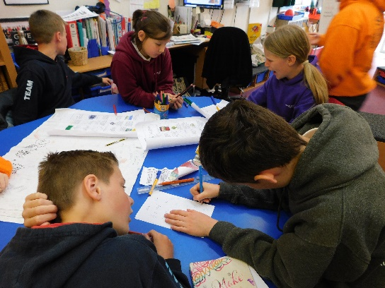
What helped you learn?
- going over questions together in maths
- regularly moving tables to work with different people
- using protractors correctly
- videos to show how things work
- having a visual timetable for each day
Even better if…
- we could have covered more activities at Forest School
- Holly could have come back and worked with us for upcycling
- we have had more time using ICT
- we had worked more with other year groups ( especially Reception)
- we could have gone further back in time to look at the history of fashion)

Slide 5
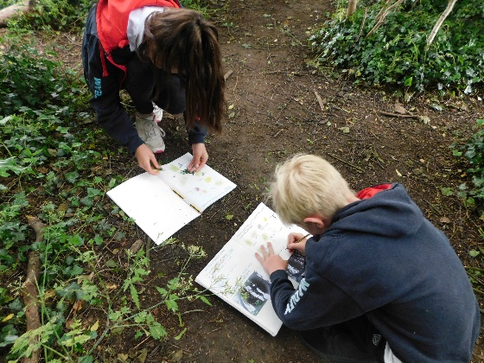
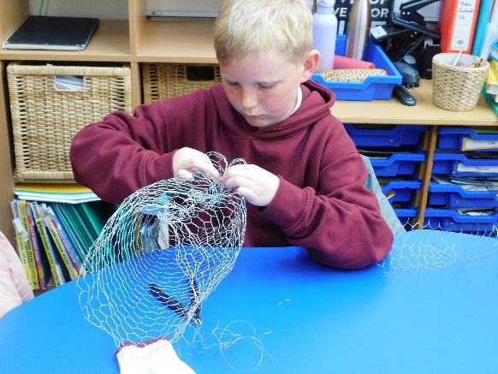
What has been the most memorable aspect of your learning?
Completing our chicken wire animals
Completing our upcycled clothes
Discussing animal reproduction
Putting our performance together & actually filming it
Challenges at forest school – both onsite and at the main site
Learning new games in PE ( handball, 5 point rounders)

