Slide 1
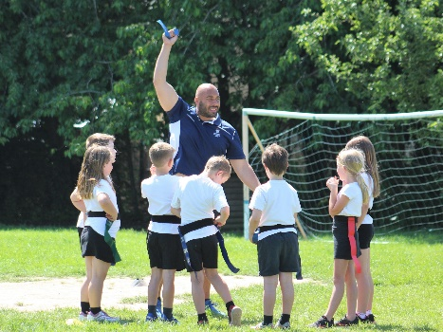
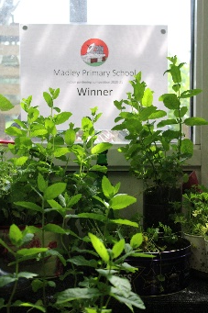
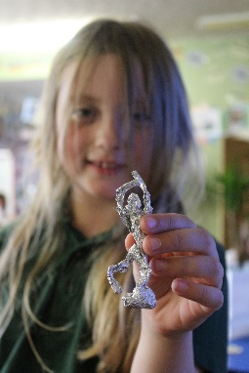
What has worked well?
Rugby – because it was fun and we improved at sprinting and dodging.
Leisure Centre –we got to do gymnastics and use the athletics facilities.
Plant Competition – we learned lots about plants and it helped us with our theme and we won!
Reading with Mrs Fleming – we have improved and tried harder books.
Mosaic leaves – successful and they made us work carefully.
Learning about LS Lowry – we saw some of his paintings and found out a lot about him.
Foil sculptures - we all made them carefully and they looked really good.

Slide 2
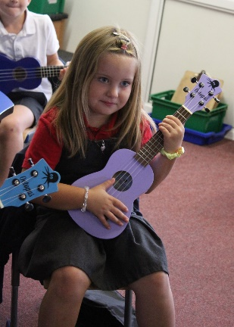
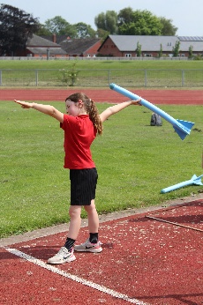
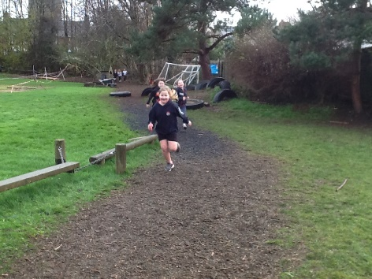
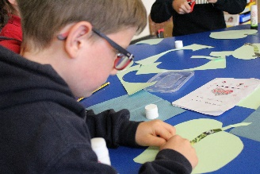
What has challenged you?
Fractions has been really hard!
Learning the higher times tables.
PE – doing laps around the bark path is hard work.
Learning different keys and following the beat in ukulele.
Learning division in maths.
Throwing the javelin at the
Leisure Centre.
Putting all the mosaic pieces in the right place when we made our mosaic leaves.

Slide 3
What has surprised you about your theme?
To discover how quickly our marigold plants grew.
That there are so many different sports that we had never heard of!
How much care we need to give to growing our plants.
With our celery experiment we were surprised to discover that the celery would suck up the food colouring in the water.
Also we were surprised by the runner beans still growing in the dark.

Slide 4
What helped you learn?
Mrs. Fleming helps us by explaining the task again.
Watching examples of what we have to do.
Using practical resources such as counters and cubes.
Even better if…
Going on more trips.
Having a go at more sports.

Slide 5
What has been the most memorable aspect of your learning?
Visiting the Leisure Centre
Rugby
PE lessons - running
Archery
Walks in the forest
Learning how to build stone bridges at Forest School
Learning about different plants
Designing a bike for Mrs Armitage
Writing versions of stories

