Slide 1
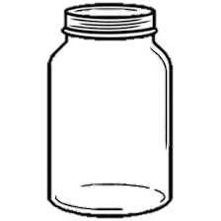
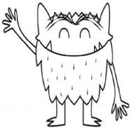
The Colour Monster
Can you help The Colour Monster fill his jars by drawing things that make you feel each of these feelings?
Sad
Fear
Calm
Love
Angry
Happy

